Slide 1
Functional analysis of the SRS

Slide 2

Steps
Define a high level functional structure
Set rules for assigning sub functions to the functional structure
Analyse the SRS, resulting in clearly defined sub functions assigned to the functional structure

Slide 3
I. Functional break down process
SUB FUCTIONS
ERA document requirements

Slide 4
II. Principles for detailing the architecture
Cyclic execution
- read all inputs received in the current cycle
- update the internal data structure with distance,
time, and input (predefined order)
- calculate outputs
- determine mode and level
No external interrupts
Fixed data structure
- internal data stored i.r.t. LRBG
(i.e. no incremental distances)
LRBG
position
X

Slide 5
IIIA. Analysis of the SRS
Describe per function:
Data: in-/outputs
Requirements with ref's to the SRS (ERA specifications)
Global description of the functions
Example: format for requirements
Discussion: the balance between work and level of formalism

Slide 6
IIIB. Process
Steps in analysing the SRS:
Analyse a part of the SRS (e.g. a paragraph)
Define the OBU functions (implicitly) described
Gather all relevant requirements (also from other parts)
Register the coverage of SRS requirements by the defined function
Define the in and output variables (also internal)
Add the function to the overall functional structure

Slide 7
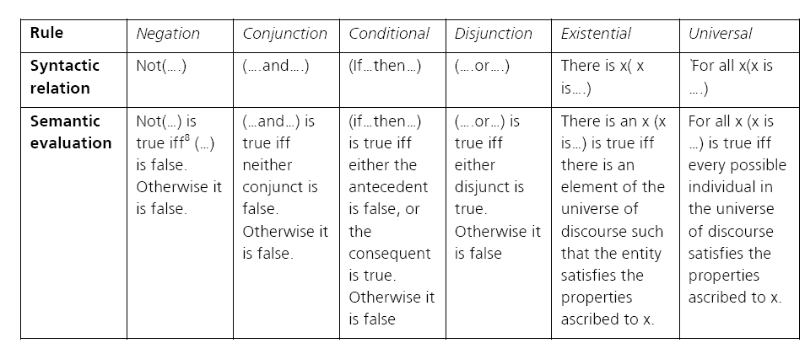
Requirement structuring

Slide 8
IIIC. Example MA
MA's can be given using 3 different data structures
Distances given incremental
Maximum number of sections not clear
….
Data structure and sub functions defined:
Sub functions for storing and updating an MA
Initialize the MA according to the default values.
Check if a received MA is valid (direction, ssp, gradient available,....)
Delete the existing MA (as far as necessary) if a new MA is received.
Store MA data (except timers)
Store and update timers when a new MA is received
Update MA for time elapsed: Check timers and apply applicable actions
Update MA for a new LRBG
Update MA for a distance driven

Slide 9
Example data structure MA
8.3_1
MA structure: (one instance of this type only)
The number of sections in the MA (default 0, maximum including the end section: 34)
Sections as defined in 8.3_3
End section information (additional information concerning the furthest MA section):
• An “end section timer start location” (related to the LRBG) (default: infinite)
• An “end section timer” (see 8.3_4)
• Limit of authority speed. (default: 0)
• A Limit of authority “(LOA) timer (see 8.3_2)
• Danger point distance: distance beyond EOA to the danger point (“0” if not available) (default: 0)
• The release speed related to the danger point. (default: 0)
• Overlap distance: the distance beyond the EOA to the end of the overlap (default: 0)
• The release speed related to the overlap. (default: 0)
• The overlap timer start location (related to the LRBG) (default: infinite)
• An “overlap timer” (see 8.3_4)
The signalling related maximum speed (only applicable in level 1)

